Slide 1
Engineer Data for Business Insights Team 06 – JinHui, Jeremy Gan
Date: 5 Feb 2026

Slide 2
Background
The National Environment Agency (NEA) is the leading public organisation responsible for ensuring a clean and sustainable environment for Singapore. Its key roles are to improve and sustain a clean environment, promote sustainability and resource efficiency, maintain high public health standards, provide timely and reliable meteorological information, and encourage a vibrant hawker culture.
NEA works closely with its partners and the community to develop and spearhead environmental and public health initiatives and programmes. It is committed to motivating every individual to care for the environment as a way of life, in order to build a liveable and sustainable Singapore for present and future generations.
Members of public would like to have sufficiently precise, personalised, and user-friendly tool to make informed decision for any outdoor commute or activities amidst unpredictable tropical weather in Singapore.
Specialised communities (e.g. aviation industries, golf courses, swimming pools) rely on accurate and timely weather for flight safety purposes, or for workplace safety and health purposes.

Slide 3
Pain Points
1. The Context Void (Personalization)
The Pain: Weather apps provide raw meteorological data (Temperature, Humidity, Rain Probability) but lack activity context.
The Reality: A "30% chance of rain" means something different to a Runner (risk of slipping), a Parent (playground is wet), or a Commuter (need an umbrella).
User Frustration: Users have to mentally translate raw data into "Is it safe to do X?", often leading to poor judgment calls.
2. The Granularity Gap (Spatial - Location precision)
The Pain: Current forecasts provide "City-Wide" or broad regional averages (e.g., "Afternoon Thunderstorms in the West").
The Reality: Singapore’s tropical weather is hyper-local. It can be pouring in Clementi but dry in Jurong East (just 3km away).
User Frustration: Users make decisions based on broad data, only to find the reality at their specific location is completely different.
3.. The Volatility Factor (Temporal - Timeframe precision)
The Pain: Tropical squalls are transient and sudden. Static forecasts (updated hourly) often lag behind real-time changes.
The Reality: The "window of opportunity" for outdoor activities is often small and unpredictable.
User Frustration: Wasted time, cancelled plans, and the "stranded commuter" phenomenon—getting stuck mid-journey because the data wasn't real-time enough.

Slide 4
Problem Statement
The Operational Bottleneck
Meteorological agencies currently face a critical latency gap. Manual forecasting workflows, which usually takes 30 to 60 mins, often lag behind the 30-minute lifecycle of tropical micro-squalls, forcing forecasters to issue broad, region-wide alerts that fail to capture hyper-local ground truth.
The Credibility Gap (Inaccuracy)
This lack of granularity drives a volume of public complaints regarding "perceived inaccuracy." Frequent false alarms (predicted rain, actual sun) and missed warnings have rendered generic forecasts unreliable, leading users to disregard official data.
The Safety & Lifestyle Impact
Consequently, the public faces decision paralysis and avoidable safety risks. The inability to distinguish between a general regional risk and an immediate local threat leads to unnecessary disruptions for commuters and outdoor facility managers.

Slide 5
Success Metrics
🏛️ Public Trust & Service Excellence
5K
Monthly Active Users (12 mths)
App analytics
<0.5mm
Forecast vs Actual Deviation (MAE)
Prediction vs actual readings
⚙️ Operational Efficiency
≥90%
Forecasting Automation Rate
No manual intervention
99.5%
Pipeline Uptime
Monitoring dashboard
📊 Data-Driven Governance
Top 50
Searched Locations
Aggregated search analytics
≥80%
Sensor Utilisation Rate
% of NEA sensors consumed
≥60% Repeat Usage Rate (7-day) Returning users within 7 days
<5min
Anomaly-to-Alert Response Time
Data anomaly to notification
📈
Search Query Volume Trend
Monthly API logs
🇸🇬 Smart Nation Alignment
Open Data API Published
data.gov.sg listing
AI Model Transparency
Model card publication

Slide 6
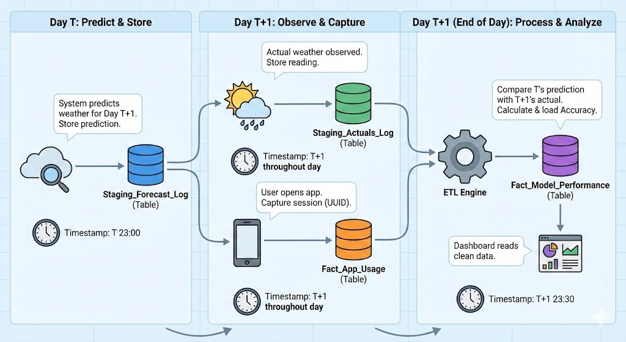
Process Flow Chart

Slide 7
Data Process Flow Chart
Collect Raw Data
Cloud Images from Japan satellite (Himarwari-8/9)
Pre-Processing
Cleansing
Model Training Strategy
Forecast
Forecast based on the user’s enquire
Store the data (location, forecast outcome and user account for further improvement on accuracy of the model
Raining, temperature, humanity and PM2.5 from data.gov.sg
All data will be kept in data lake (S3 bucket) for pre-processing processing
Timestamp Alignment Strategy (Resample to unified frequency)

Slide 8
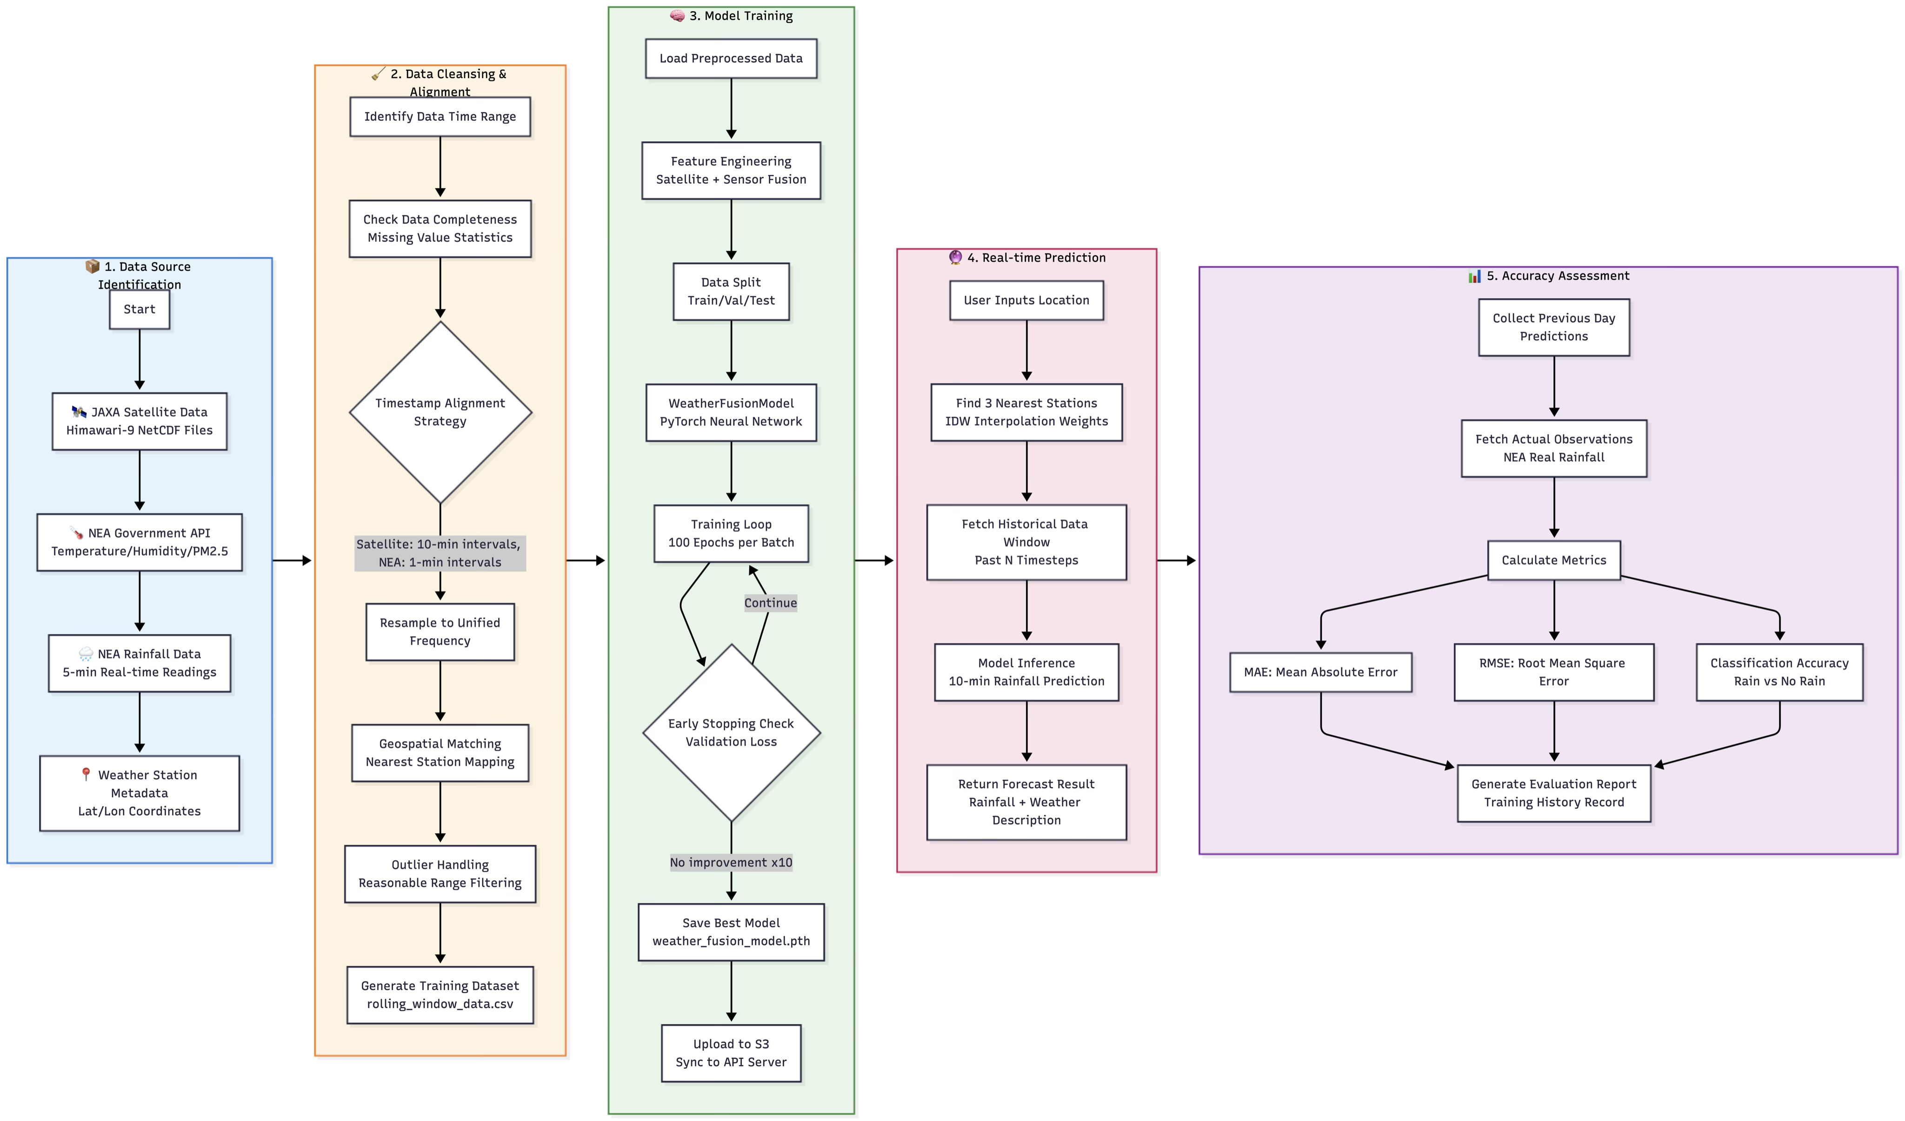
Detailed Step Process Flow Chart

Slide 9
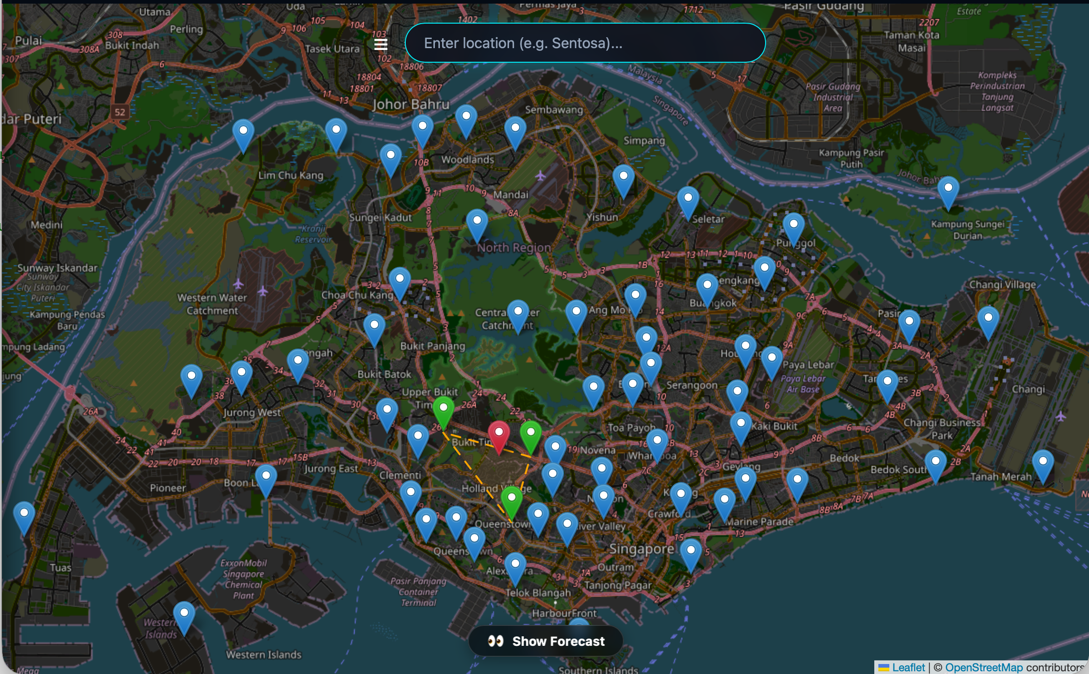
🌦️ Singapore Weather AI
AI-Powered Rainfall Prediction System
Satellite + Sensor Data Fusion • Deep Learning • Real-Time API
🛰️
Himawari-9
Satellite Data Source
📡
NEA API
Sensor Data Source
🧠
CNN+LSTM
Fusion Model
⚡
<200ms
Prediction Speed

Slide 10
Feather 1 – Data Ingestion & Processing
Satellite Data
Himawari-9 infrared imagery from JAXA FTP
Sensor Data
NEA API: Temperature, Humidity, Rainfall, PM2.5
Batch download + incremental updates
Auto-crop Singapore region
Parallel download (xargs -P)
NetCDF → NumPy conversion
SSL certificate verification
Auto-resample to 10-min intervals
Smart timestamp alignment (UTC ↔ SGT)
100% satellite-sensor data parity

Slide 11
Feather 2 – Deep Learning Fusion Model
3-layer CNN + BatchNorm + AdaptiveAvgPool
LSTM temporal encoder for sensor sequences
Dropout-regularized fusion head
10-minute ahead rainfall prediction
GPU / CPU / Apple MPS adaptive
Incremental learning with checkpoint loading
Smart 3→4 feature dimension migration
Dynamic epochs (initial: 100, incremental: 5)

Slide 12
Feather 3 – Automated Training System
🔧 PreProcess
🧠 Train
📄 Report
📊 Evaluate
📧 Email
📥 Download
Daily Pipeline🔄
End-to-end automation
Batch Scheduler📅
Day-by-day historical training
History & Reporting📊
Training metrics tracking
Failure auto-retry
HTML report generation
Gmail email notifications
S3 data readiness detection
Train → Cleanup → Archive
Real-time dashboard sync
Performance trend analysis
S3 checkpoint persistence
Rolling window training

Slide 13
Feather 4 – Prediction API Service
Endpoint | Method | Description
/predict | GET | Single-point prediction by location name or lat/lon coordinates
/predict/path | GET | Path weather prediction — sampling every 2km along route
/health | GET | Service health check
/stations | GET | Weather station metadata and locations
/log-search | POST | Log user search history
/popular-searches | GET | Popular search ranking and statistics
🔢IDW Interpolation
Inverse Distance Weighting using 3 nearest sensors for spatial accuracy
🗺️OpenStreetMap
Forward/reverse geocoding for location name and coordinate resolution
♻️Model Hot-Reload
Automatic model refresh from S3 without service restart

Slide 14
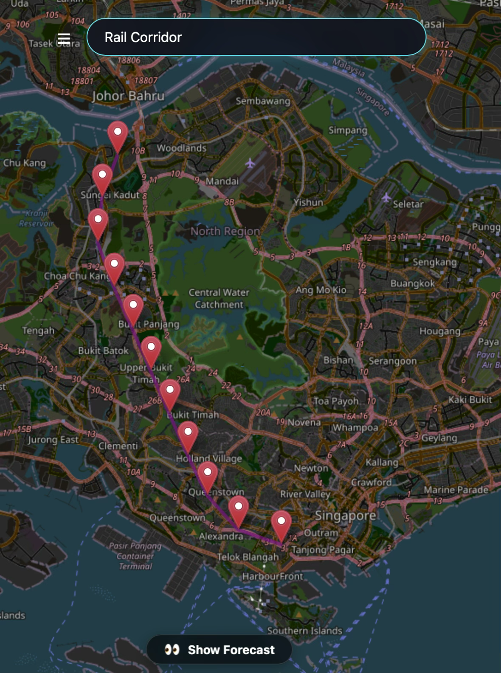
Feature 5 – Frontend Application
🗺️
Interactive Map & Prediction
Leaflet map — click anywhere for prediction
Path/landmark search with route weather
Weather station markers (configurable)
Forecast panel: rainfall, temperature, humidity
Weather icon animations
Quick search links
⚙️
App Features
React + TypeScript + Vite
Responsive design (desktop + mobile)
Side navigation menu
Settings with localStorage persistence
Search analytics (Stats page)
Global ConfigContext for state management
Example: “Rail Corridor”, “East Coast Park”
Fetches route geometry from OpenStreetMap
Samples points along the path
Predicts weather at each sample point
Visualises path with color-coded forecast markers

Slide 15
Feature 6 – Monitoring Dashboard
📥
File Download Tab
Daily download progress
Completed days counter
Satellite file count
NEA data file count
Per-day status table
🧠
Training Process Tab
4-phase progress stepper
Current batch & epoch count
Training history table
MAE / RMSE metrics
Success/failure status
🚀
API Application Tab
Model sync status
Sensor data sync status
Last sync timestamp
Service health indicator
Log viewer with highlighting

Slide 16
Feature 7 – Operational
System Metrics
MAE (Mean Absolute Error)
DevOps
Automation & Sync
Environment Separation
Tech Stack
PyTorch
React
TypeScript
Infra
Download Server
Training Server
API Server
S3 Data Lake
Cloudfront
Terraform
RMSE
Accuracy
Requests / Second
Path Prediction
Single Point Prediction
Bidirectional S3 Sync

Slide 17
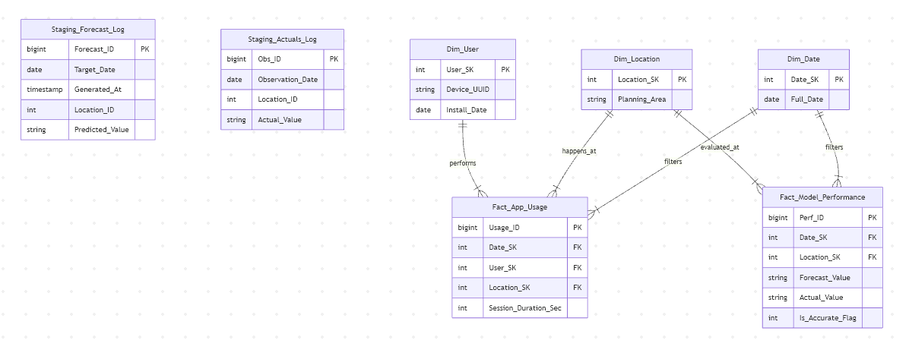
ER Diagram

